Slide 1
Intel® oneAPI CodeMaven
Techgig
Theme: Predicting consumer sentiments
Team Name: The Underdog
Team Members: Mohamed Farhun M
Manish R
Abishek R

Slide 2
Theme Chosen and Motivation
Theme:- Predicting consumer sentiments –Safe&Secure
Introduction:-
Many use pricey GPUs to shorten training and inference times for machine learning on industrial datasets that are getting bigger and bigger.
Our project's demonstration will demonstrate how you may speed up your machine learning workflow utilising Intel's optimised libraries, which are both affordable and streamlined.
Our code predicts the sentiments underlying tweets received in real time using tweepy and categorise them as positive, negative, or neutral, this script first performs EDA before preprocessing numerous datasets to train a bidirectional LSTM model..

Slide 3
Proposed Tech Architecture
(Highlight usage of oneAPI data analytics toolkit)
In this project,I have demonstrated the results of research by predicting consumer sentiments using bidirectional LSTM model
IntelOneAPI toolkits:-
This reference notebook will show you how to use multiple accelerated Python libraries included in the Intel® AI Analytics Toolkit to improve your ML workflow's training cycles, prediction throughput, and accuracy (AI Kit).
The principal libraries we'll use in this notebook are:
Intel® Distribution of Modin*
Intel® Extension for Scikit-learn*
XGBoost Optimized for Intel® Architecture 4.Intel® Daal4py
5. Intel® Extension for Pytorch
6. Intel®Optimization for Tensorflow

Slide 4
Impact of inclusion of oneAPI
Hardware Requirements:-
I have used 5th generation of Intel(R) Xeon(R) Core(TM) i5- 10210U CPU @ 1.60GHz 2.11 GHz
The Intel® Distribution of Modin:-It is used to process and study the data first. With support for datasets from 1 MB to 1 TB+, the Intel® Distribution of Modin is a distributed DataFrame library created to expand your pandas process naturally with the size of your dataset.
Intel® Extension for Scikit-learn:-For Intel® CPUs and GPUs in single- and multi- node setups, the Intel® Extension for Scikit-learn delivers seamless integration with scikit-learn applications while shortening algorithm run times.
Intel® Daal4py library:-With the help of the get gbt model from xgboost() method, it is quite simple to convert a tuned XGBoost model to Daal4py in just one line of code. after using Intel® Daal4py library,the execution time is lesser than before.It gives predictions with better time performances.

Slide 5
Impact of inclusion of oneAPI
The Intel® Extension for Pytorch:- The Intel Extension for PyTorch provides an additional set of custom operators and optimizers for common use-cases in addition to replacing a portion of the ATen operators with their optimised equivalents. Additional graph optimisation steps are used in graph mode to boost speed.
Intel Optimization for TensorFlow:- On Intel hardware, TensorFlow-based training and inference turnaround times are accelerated through Intel Optimisation for TensorFlow. It enhances TensorFlow to speed up performance on Intel GPU and CPU hardware even further.
Intel® oneAPI Deep Neural Network Library (oneDNN):-It abstracts away instruction sets and other performance optimisation complications, developers of deep learning applications and frameworks can utilise the same API for CPUs, GPUs, or both. uses improved building blocks to create deep learning applications and frameworks more quickly.

Slide 6
Innovation Quotient and Scalability
Due to enormous amount of online reviews in digital form, interest in sentiment analysis from unstructured text has increased dramatically in recent years.
Our Safe&Secure project offers a reliable method for predicting sentiments and could allow us to gauge online customers preferences and extract opinions from the Internet.
The dataset which I took was tweets, twitter-data,apple-twitter-sentiment.For further reference of the dataset visit my github.(Download all the datasets and run the cells in colaboratory).
We can categorize each sentence as positive, negative and neutral and predict the consumer sentiments using bidirectional LSTM method.

Slide 7
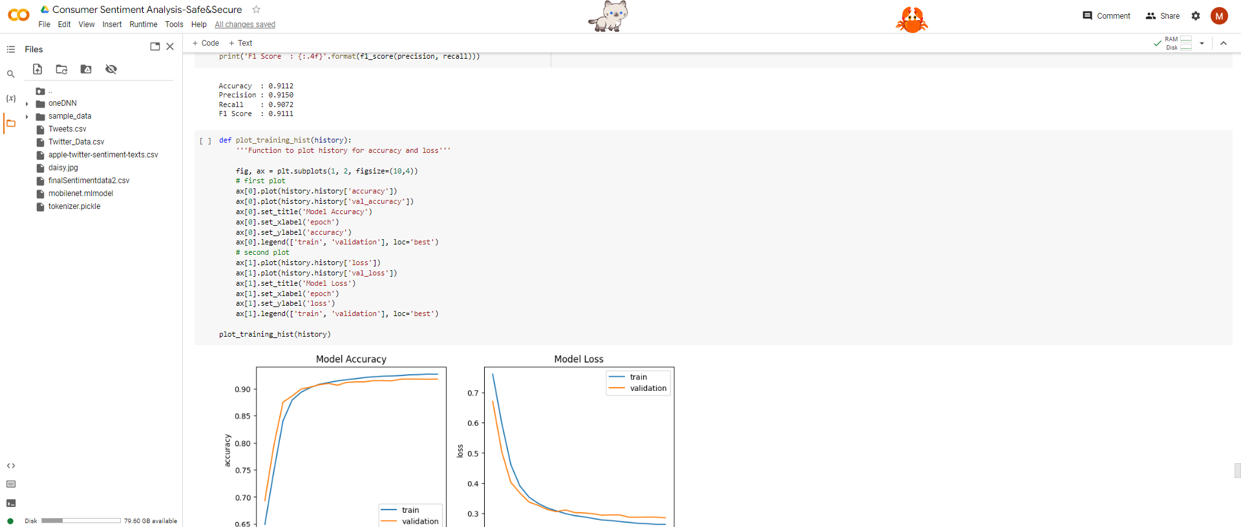
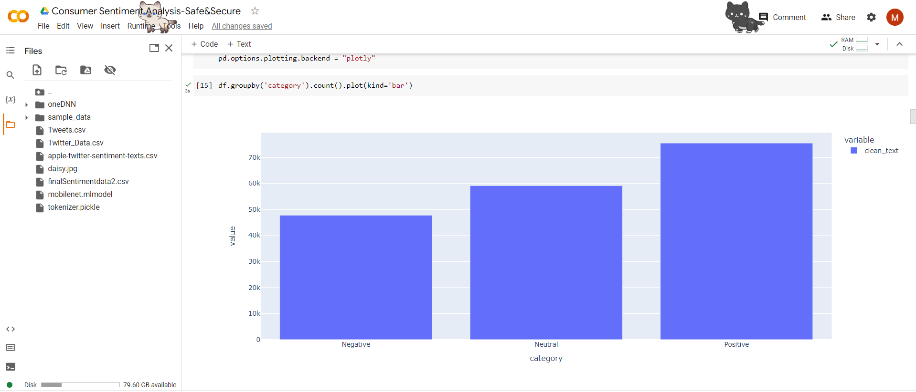
Technologies used and screenshots:-
It uses methods based on the Bidirectional LSTM, A recurrent neural network used largely for natural language processing is called Bidirectional LSTM (BiLSTM). It may use data from both sides and, unlike regular LSTM, the input flows in both directions. Bidirectional LSTM models are useful for a variety of NLP applications, including entity recognition, translation, and sentence categorization.
Techniques such as Logistic Regression,XGboosting and Linear Regression are used.
DPC++ Essentials
6

Slide 8
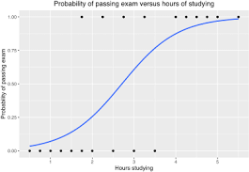
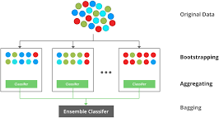

Machine Learning Algorithms
Logistic Regression
XGBoosting
DPC++ Essentials
7

Slide 9
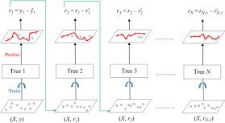
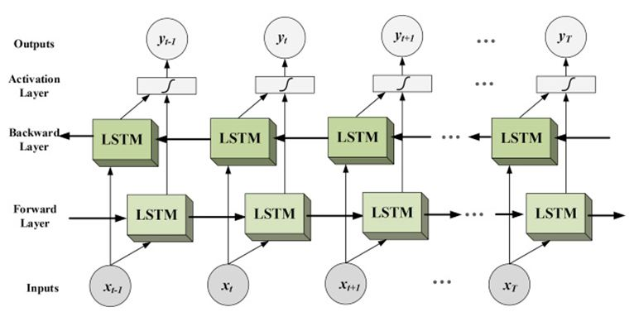
Machine Learning Algorithms
Linear Regression
Bidirectional LSTM
DPC++ Essentials
8

Slide 10
Criteria for judging:-
Adaptability:-
Owners will be unaware of the knowledge of customers and predicting their needs and comments play a vital role in keeping them happy,a problem that our project Safe&Secure excels at solving.
It takes into account adaptive technology designs to sharpen reactions, provides rich customer insight
Agility:-
You will have an advantage over your rivals if you use sentiment analysis. You'll be more nimble when seizing chances and more accurate when predicting trends. Additionally, you'll be better able to engage your audience and offer first-rate customer service. Our project Safe&Secure does that.

Slide 11
Criteria for judging:-
Sustainability:-
In a 2020 McKinsey US consumer sentiment poll, more than 60% of respondents stated they would pay more for a product with sustainable packaging. This shows that customers care much about purchasing ecologically and morally sustainable items. Our project will boost clients' earnings on a certain social media network.
This project's construction of a bidirectional neural network model can help forecast other macroeconomic indicators in practise. The model may be expanded to other forecasting studies. Future studies should definitely go in this direction.
Value impact:-
Businesses use customer sentiment as a statistic to gauge what their target market thinks and feels about their product or service. Despite being a straightforward assessment tool, it keeps note of whether users have favourable, unfavourable, or neutral opinions. Our project achieves this.

Slide 12
Criteria for judging:-
Design:-
The design is scalable to support high volumes of data since I have used Intel distribution of Modin. The package used to get data is from tweepy
Overall usability:-
The output of the solution is to predict consumer sentiments at a very high accuracy and to use IntelOneAPI analytics toolkit efficiently which is relevant to the problem described.
About 90% of desired functionalities have been covered.
Prototype build:-
Minimum viable code for the product was created for target audience with useful functionalities.
Relevant coding practices have been taken into consideration along with advanced algorithms.

Slide 13
Quick Summary
To quickly and accurately predict the consumer sentiments, we created an automated predictable consumer sentiments application framework based on XGBoost algorithms and Bidirectional LSTM
To clean, validate, and extract the pertinent features from given data, several data analysis techniques are utilised, such as data validation, data insertion, data preprocessing
After POC round:-
Live Twitter sentiment Analysis:-
We would be deploying our project in streamlit as an app ,we will be using live twitter analysis for predicting the consumer sentiments
To use the 'tweepy' API, you need to create an account with Twitter Developer. This needs more time since the data is collected live.(In Finale)

Slide 14
Video and demo submission
Video Link:- https://www.youtube.com/watch?v=V6ssjkzE-Z0
Demo link:- https://colab.research.google.com/drive/1gApPsEBQ9yRShSYhj3O5S7WZY59Lifwt?usp=sharing
Github Link:-https://github.com/MohamedFarhun/IntelOneAPICodeMaven_Safe-Secure

Slide 15
10

